Slide 1
Resolving Deadlocks
Operating Systems

Slide 2
What is a Deadlock?
A set of processes permanently waiting for resources.
No process can proceed because each waits for another.

Slide 3
Necessary Conditions
Mutual Exclusion
Hold and Wait
No Preemption
Circular Wait

Slide 4
Approaches to Handle Deadlocks
Prevention
Avoidance
Detection
Recovery

Slide 5
Deadlock Prevention
Break one of the four necessary conditions.
Example: request all resources at once.
Allow resource preemption where possible.

Slide 6
Deadlock Avoidance
System examines requests before allocation.
Uses safe-state concept.
Banker's Algorithm is a popular method.
Banker's Algorithm is a deadlock avoidance algorithm that checks whether allocating a requested resource will keep the system in a safe state.
It grants a resource request only if all processes can still complete in some safe sequence.
If the request leads to an unsafe state, the process must wait until resources become available.

Slide 7
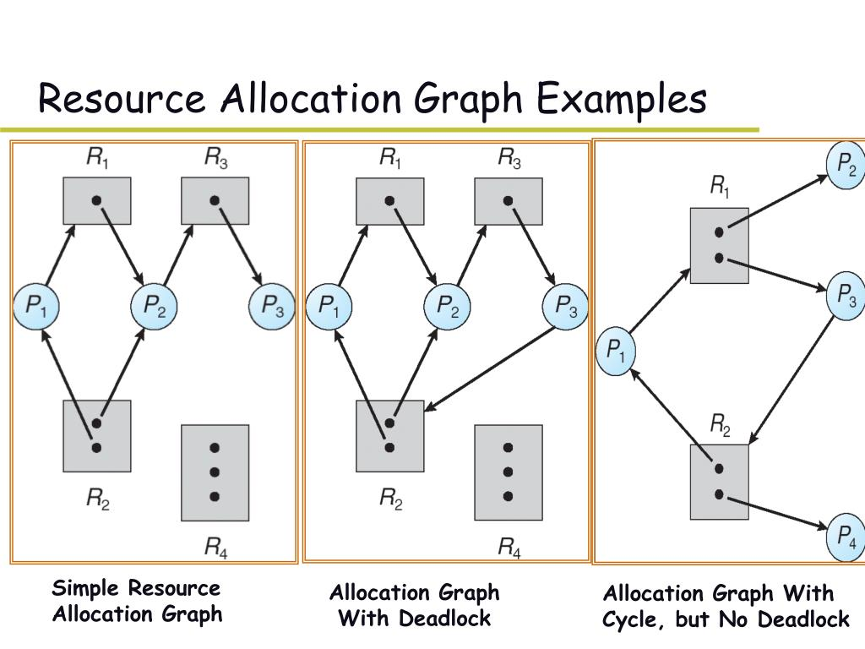
Detection and Recovery
Periodically detect cycles in resource-allocation graph.
Terminate processes or preempt resources.
Rollback affected processes if supported.

